Slide 1
Block Diagram of Intel 8086
T. V. Murali Krishna
Asst. Professor

Slide 2
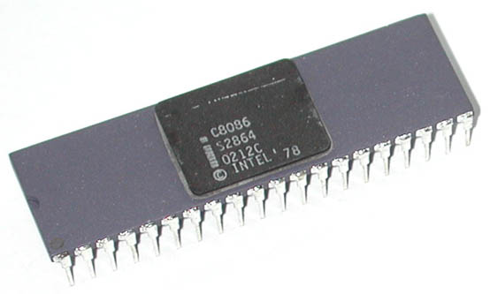
Intel 8086
Intel 8086 was launched in 1978.
It was the first 16-bit microprocessor.
This microprocessor had major improvement over the execution speed of 8085.
It is available as 40-pin Dual-Inline-Package (DIP).

Slide 3
Intel 8086
It is available in three versions:
8086 (5 MHz)
8086-2 (8 MHz)
8086-1 (10 MHz)

Slide 4
Intel 8086
It has a 16 line data bus.
And 20 line address bus.
It could address up to 1 MB of memory.
It has more than 20,000 instructions.
It supports multiplication and division.

Slide 5
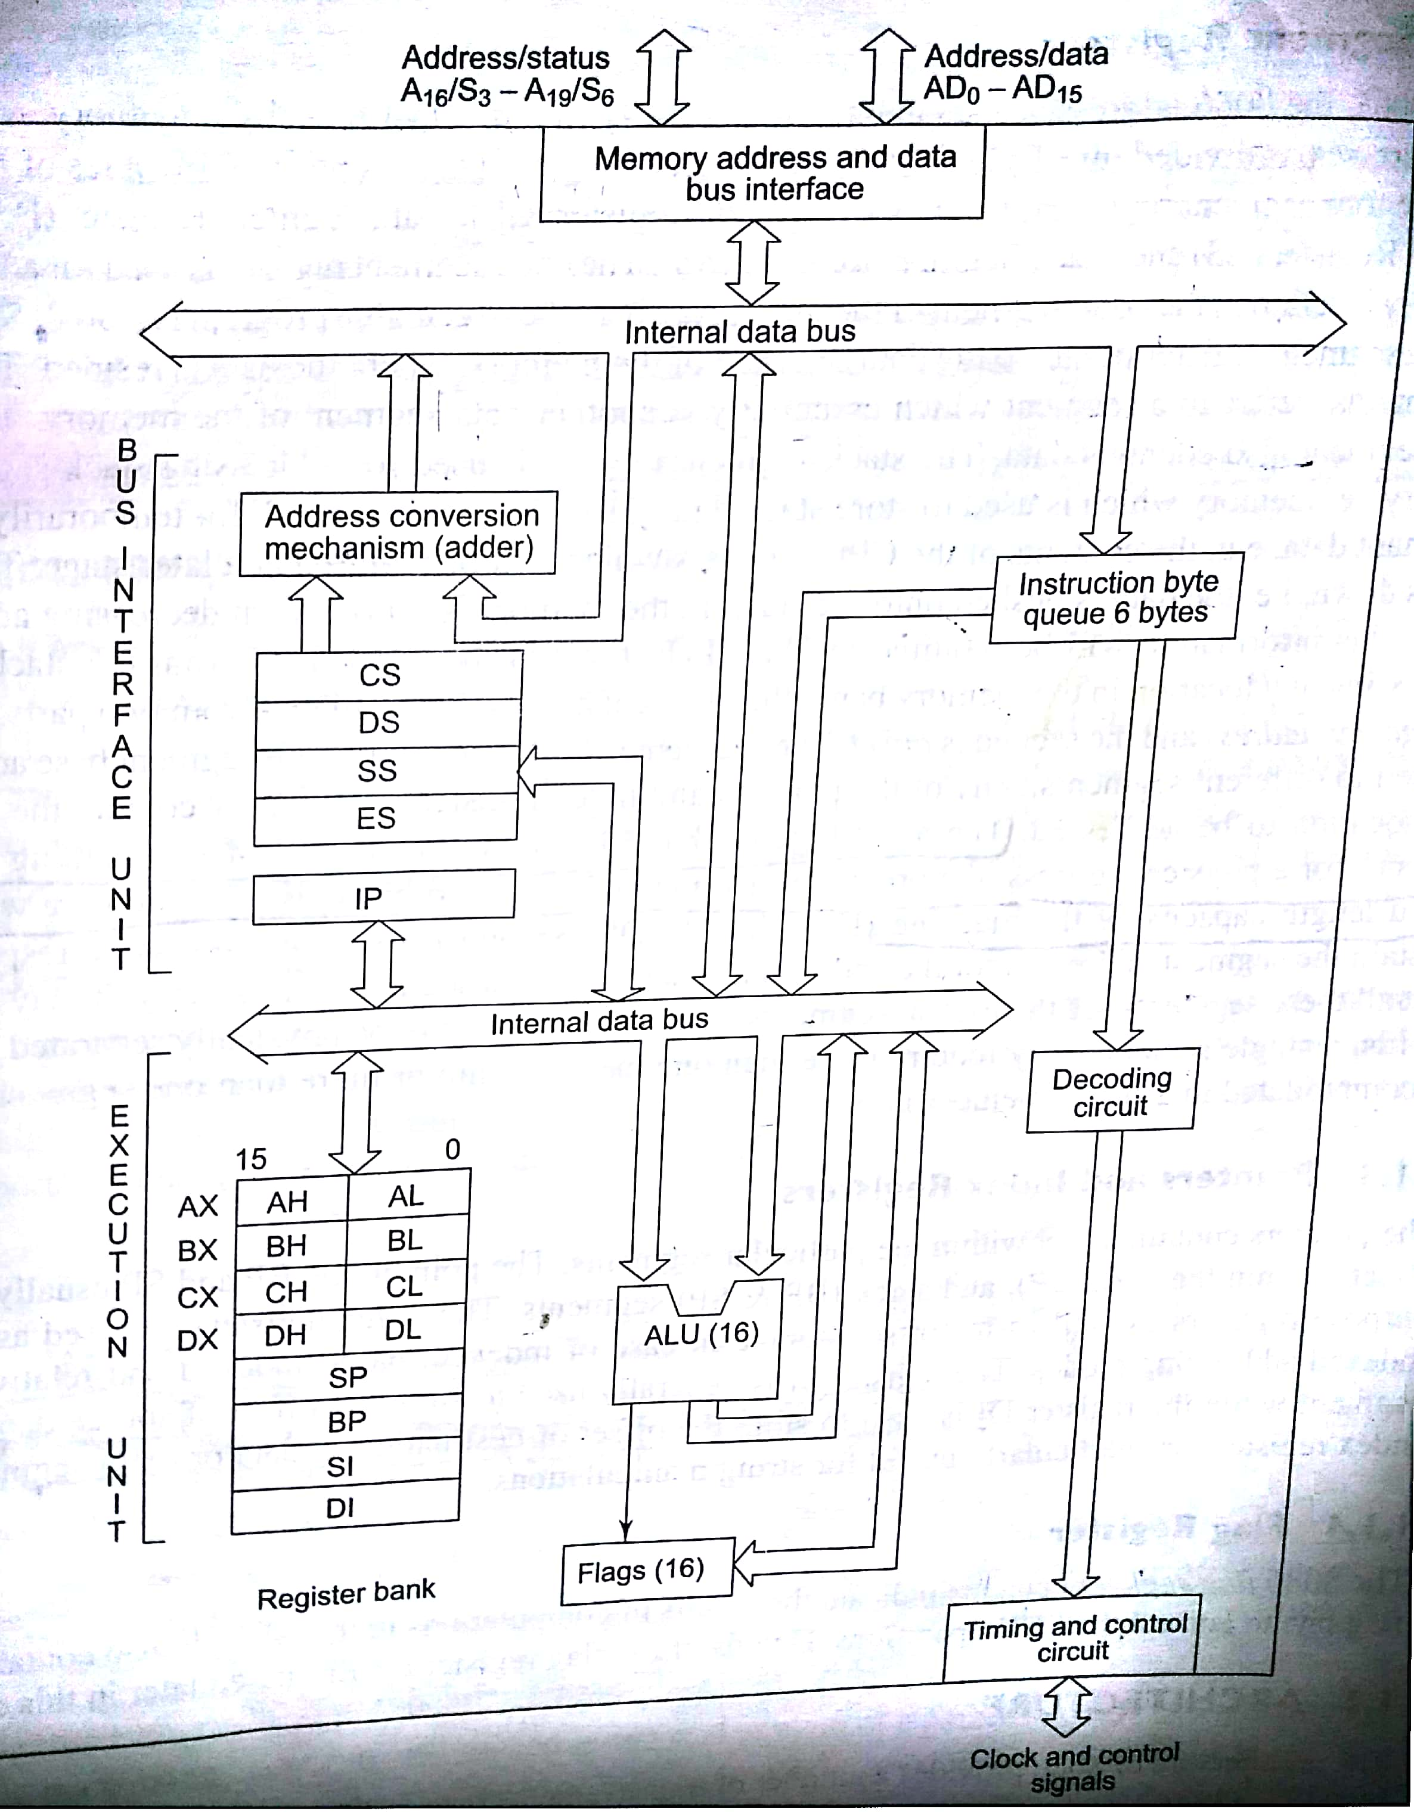
Architecture of Intel 8086

Slide 6
Block Diagram of Intel 8086
Intel 8086 contains two independent functional units:
Bus Interface Unit (BIU)
Execution Unit (EU)

Slide 7
Bus Interface Unit
Bus Interface Unit contains:
Segment Registers
Instruction Pointer
6-Byte Instruction Queue
Adder/summer circuit

Slide 8
Execution Unit
Execution Unit contains:
General Purposes Registers
Stack Pointer
Base Pointer
Index Registers
ALU
Flag Register
Instruction Decoder
Timing & Control Unit

Slide 9
Functions of Bus Interface Unit
It handles transfer of data and addresses between the processor and memory / IO.
It reads data from memory and I/O devices.
It writes data to memory and I/O devices.
It computes and sends out addresses.
It fetches instruction codes.
It stores fetched instruction codes in a FIFO register called QUEUE.

Slide 10
Instruction Queue
To increase the execution speed, BIU fetches as many as six instruction bytes ahead to time from memory.
All six bytes are then held in first-in-first-out 6-byte register called instruction queue.
Then all bytes are given to EU one by one.
This pre-fetching operation of BIU may be in parallel with execution operation of EU, which improves the execution speed of the instruction.

Slide 11
Functions of Execution Unit
It receives opcode of an instruction from the QUEUE.
An opcode is the first byte of an instruction in machine language which tells the hardware what operation needs to be performed with this instruction.
It decodes it and then executes it.
It tells BIU where to fetch the instructions or data from.
It contains the control circuitry to perform various internal operations.
It has 16-bit ALU, which can perform arithmetic and logical operations on 8-bit as well as 16-bit data.

Slide 12
Pipelining
While EU executes instructions, BIU fetches instructions from memory and stores them in the QUEUE.
BIU and EU operate in parallel independent of each other.
This type of overlapped operation of the functional units of a MP is called Pipelining.

Slide 13
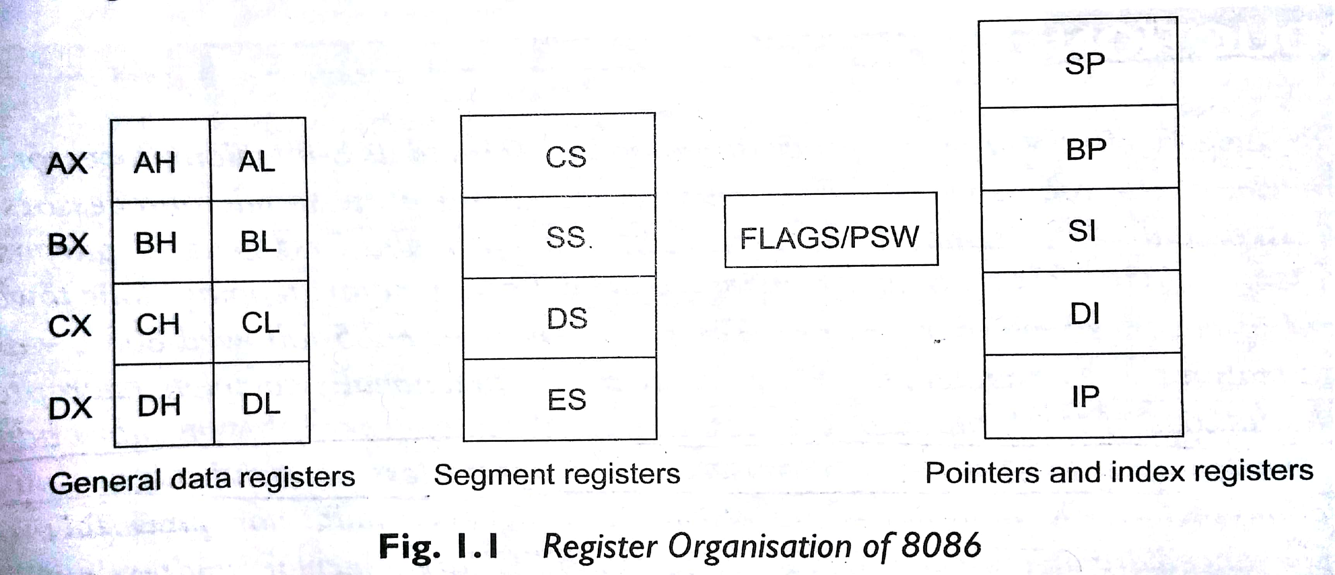
Registers of Intel 8086
Intel 8086 contains following registers:
General Purpose Registers
Pointer and Index Registers
Segment Registers
Status Flags

Slide 14
General Purpose Registers
There are four 16-bit general purpose registers:
AX
BX
CX
DX

Slide 15
General Purpose Registers
Each of these 16-bit registers are further subdivided into two 8-bit registers.
AX
BX
CX
DX
AH | AL
BH | BL
CH | CL
DH | DL

Slide 16
General Purpose Registers
AX Register: AX register is also known as accumulator register that stores operands for arithmetic operation like divided, rotate.
BX Register: This register is mainly used as a base register. It holds the starting base location of a memory region within a data segment.
CX Register: It is defined as a counter. It is primarily used in loop instruction to store loop counter.
DX Register: DX register is used to contain I/O port address for I/O instruction.

Slide 17
Pointer and Index Registers
Following four registers are under this category:
Stack Pointer (SP)
Base Pointer (BP)
Source Index (SI)
Destination Index (DI)

Slide 18
Pointer and Index Registers
Stack Pointer (SP):
It stores the address of top element in the stack.
BP, SI & DI are used in memory address computation. (Will be discussed later)

Slide 19
Segment Registers
There are four segment registers in Intel 8086:
Code Segment Register (CS)
Data Segment Register (DS)
Stack Segment Register (SS)
Extra Segment Register (ES)

Slide 20
Segment Registers
In 8086, memory is divided into four segments:
Code Segment
Data Segment
Stack Segment
Extra Segment

Slide 21
Segment Registers
A segment register points to the starting address of a memory segment.
For e.g.:
The code segment register points to the starting address of the code segment.
The data segment register points to the starting address of the data segment, and so on.
The maximum capacity of a segment may be up to 64 KB.

Slide 22
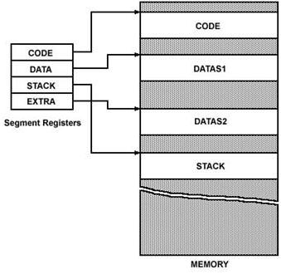
Segment Registers

Slide 23
Segment Registers
The instructions of 8086 specify 16-bit address.
But the actual physical addresses are of 20-bit.
Therefore, they are calculated using the contents of the segment registers and the effective memory address.

Slide 24
Instruction Pointer
The Instruction Pointer (IP) in 8086 acts as a Program Counter.
It points to the address of the next instruction to be executed.
Its content is automatically incremented when the execution of a program proceeds further.
The contents of the IP and Code Segment Register are used to compute the memory address of the instruction code to be fetched.
This is done during the Fetch Cycle.

Slide 25
Status Flags
Status Flags determines the current state of the accumulator.
They are modified automatically by CPU after mathematical operations.
This allows to determine the type of the result.

Slide 26

Status Flags
8086 has 16-bit status register.
It is also called Flag Register or Program Status Word (PSW).
There are nine status flags and seven bit positions remain unused.
Flag Register of 8086

Slide 27
Status Flags
8086 has 9 flags and they are divided into two categories:
Condition Flags
Control Flags

Slide 28
Status Flags
Following are the nine flags:
Condition Flags | Control Flags
Carry Flag | Trap Flag
Auxiliary Carry Flag | Interrupt Flag
Zero Flag | Directional Flag
Sign Flag
Parity Flag
Overflow Flag

Slide 29
Condition Flags
Condition flags represent result of last arithmetic or logical instruction executed. Conditional flags are as follows:
Carry Flag (CF): This flag is set if there is a carry / borrow after an integer arithmetic.
Auxiliary Carry Flag (AF): If an operation performed in ALU generates a carry / borrow from lower nibble (i.e. D₀ – D₃) to upper nibble (i.e. D₄ – D₇), then AF is set. It is used in BCD Addition.
Parity Flag (PF): This flag is used to indicate the parity of result. If the result contains even number of 1’s, the Parity Flag is set and for odd number of 1’s, the Parity Flag is reset.

Slide 30
Condition Flags
Zero Flag (ZF): It is set; if the result of arithmetic or logical operation is zero else it is reset.
Sign Flag (SF): In sign magnitude format the sign of number is indicated by MSB bit. If the result of operation is negative, sign flag is set.
Overflow Flag (OF): It occurs when signed numbers are added or subtracted. An OF indicates that the result has exceeded the capacity of machine.

Slide 31
Control Flags
Control flags are set or reset deliberately to control the operations of the execution unit. Control flags are as follows:
Trap Flag (TP):
It is used for single step control.
It allows user to execute one instruction of a program at a time for debugging.
When trap flag is set, program can be run in single step mode.

Slide 32
Control Flags
Interrupt Flag (IF):
It is an interrupt enable / disable flag.
If it is set, the INTR interrupt of 8086 is enabled and if it is reset then INTR is disabled.
It can be set by executing instruction STI and can be cleared by executing CLI instruction.

Slide 33
Control Flags
Directional Flag (DF):
It is used in string operation.
If it is set, string bytes are accessed from higher memory address to lower memory address.
When it is reset, the string bytes are accessed from lower memory address to higher memory address.
It is set with STD instruction and cleared with CLD instruction.

Slide 34
Thank You
Have a Nice Day

